Slide 1

Online Car Rental System
Quick car reservation for customers and a thorough business management solution for car rental owners.

Slide 2

Problem Statement
Car reservation and business management is complex and ineffective to manually track the rental records.
Cash based payment records bookkeeping.
Manual car inventory management
Walk-in car reservation by customers
Know Your Customer (KYC) management
Solution: An online web application to solve all the above problem.

Slide 3
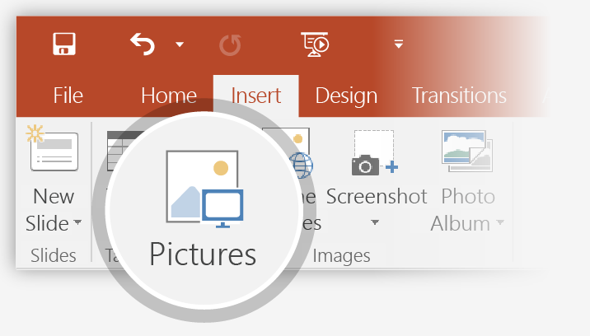
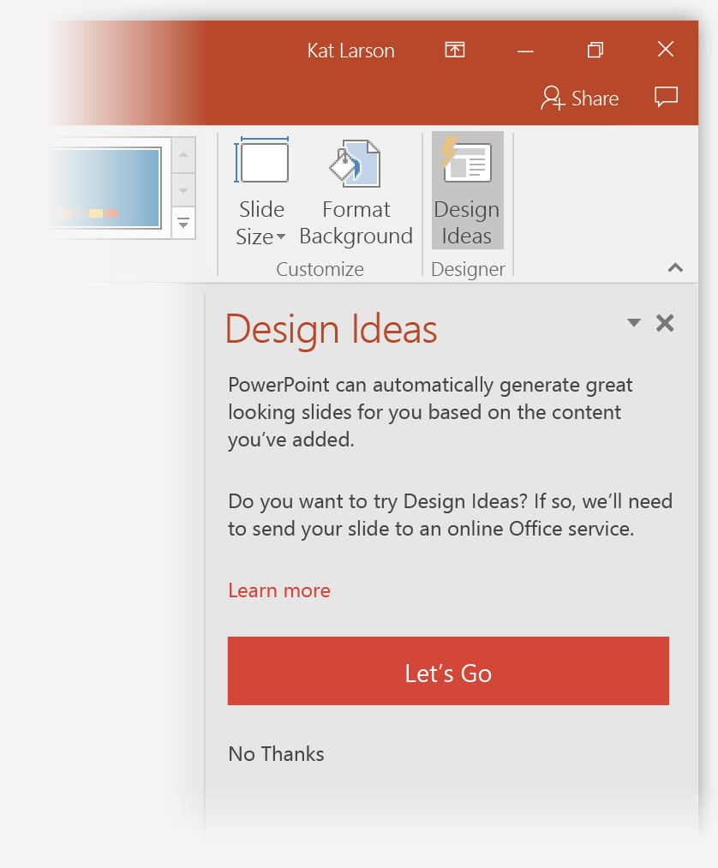
Key Features
1
Car Reservation & Payment
2
Car Inventory Management ( Car check-in & checkout )
3
Reporting
4
KYC

Slide 4
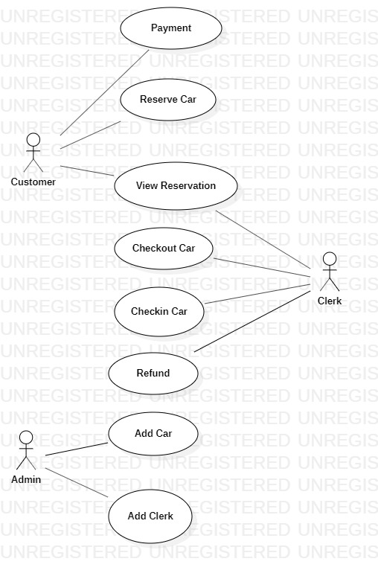
Use case Diagram

Slide 5
Use case Description 1: Reserve Car

Slide 6
Use case Description 2: Checkout Car

Slide 7
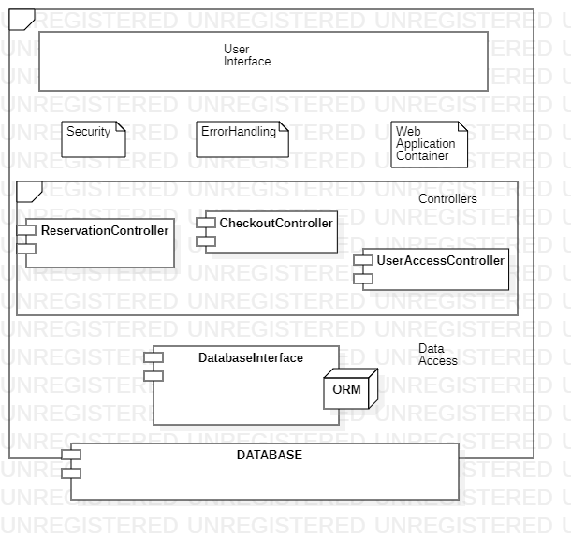
Architecture Diagram

Slide 8
Key Abstractions
2
Customer
3
Account
1
Customer
4
Car category
5
Check-out record
6
Admin
7
Check-in record
8
Car catalog
9
Credit Card
10
Clerk

Slide 9
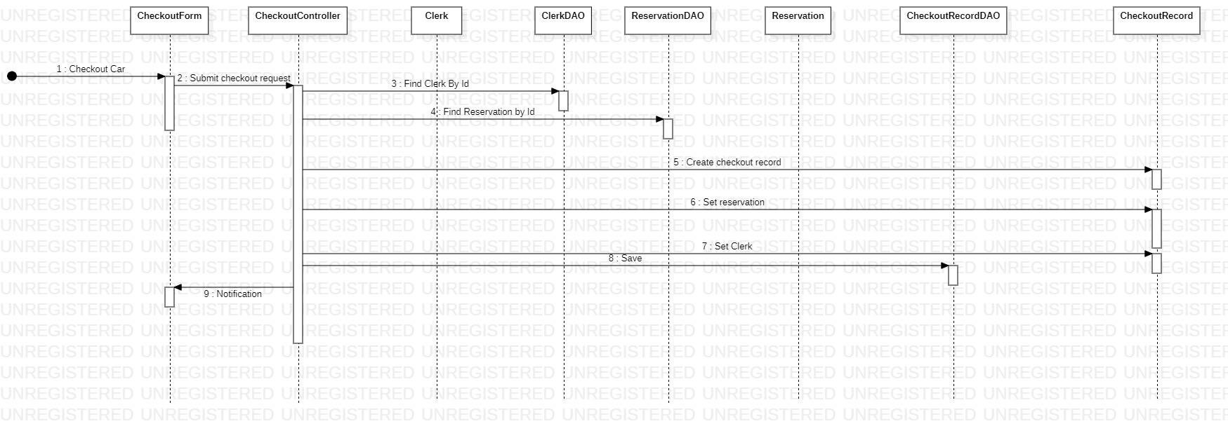
Sequence Diagram: Checkout Car

Slide 10
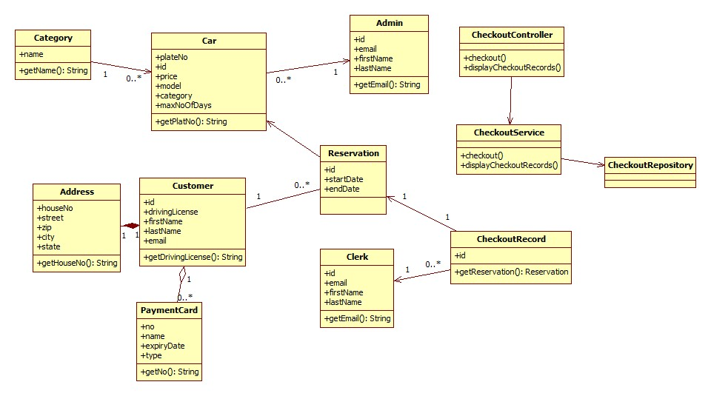
Class Diagram

Slide 11
THE END

